Slide 1
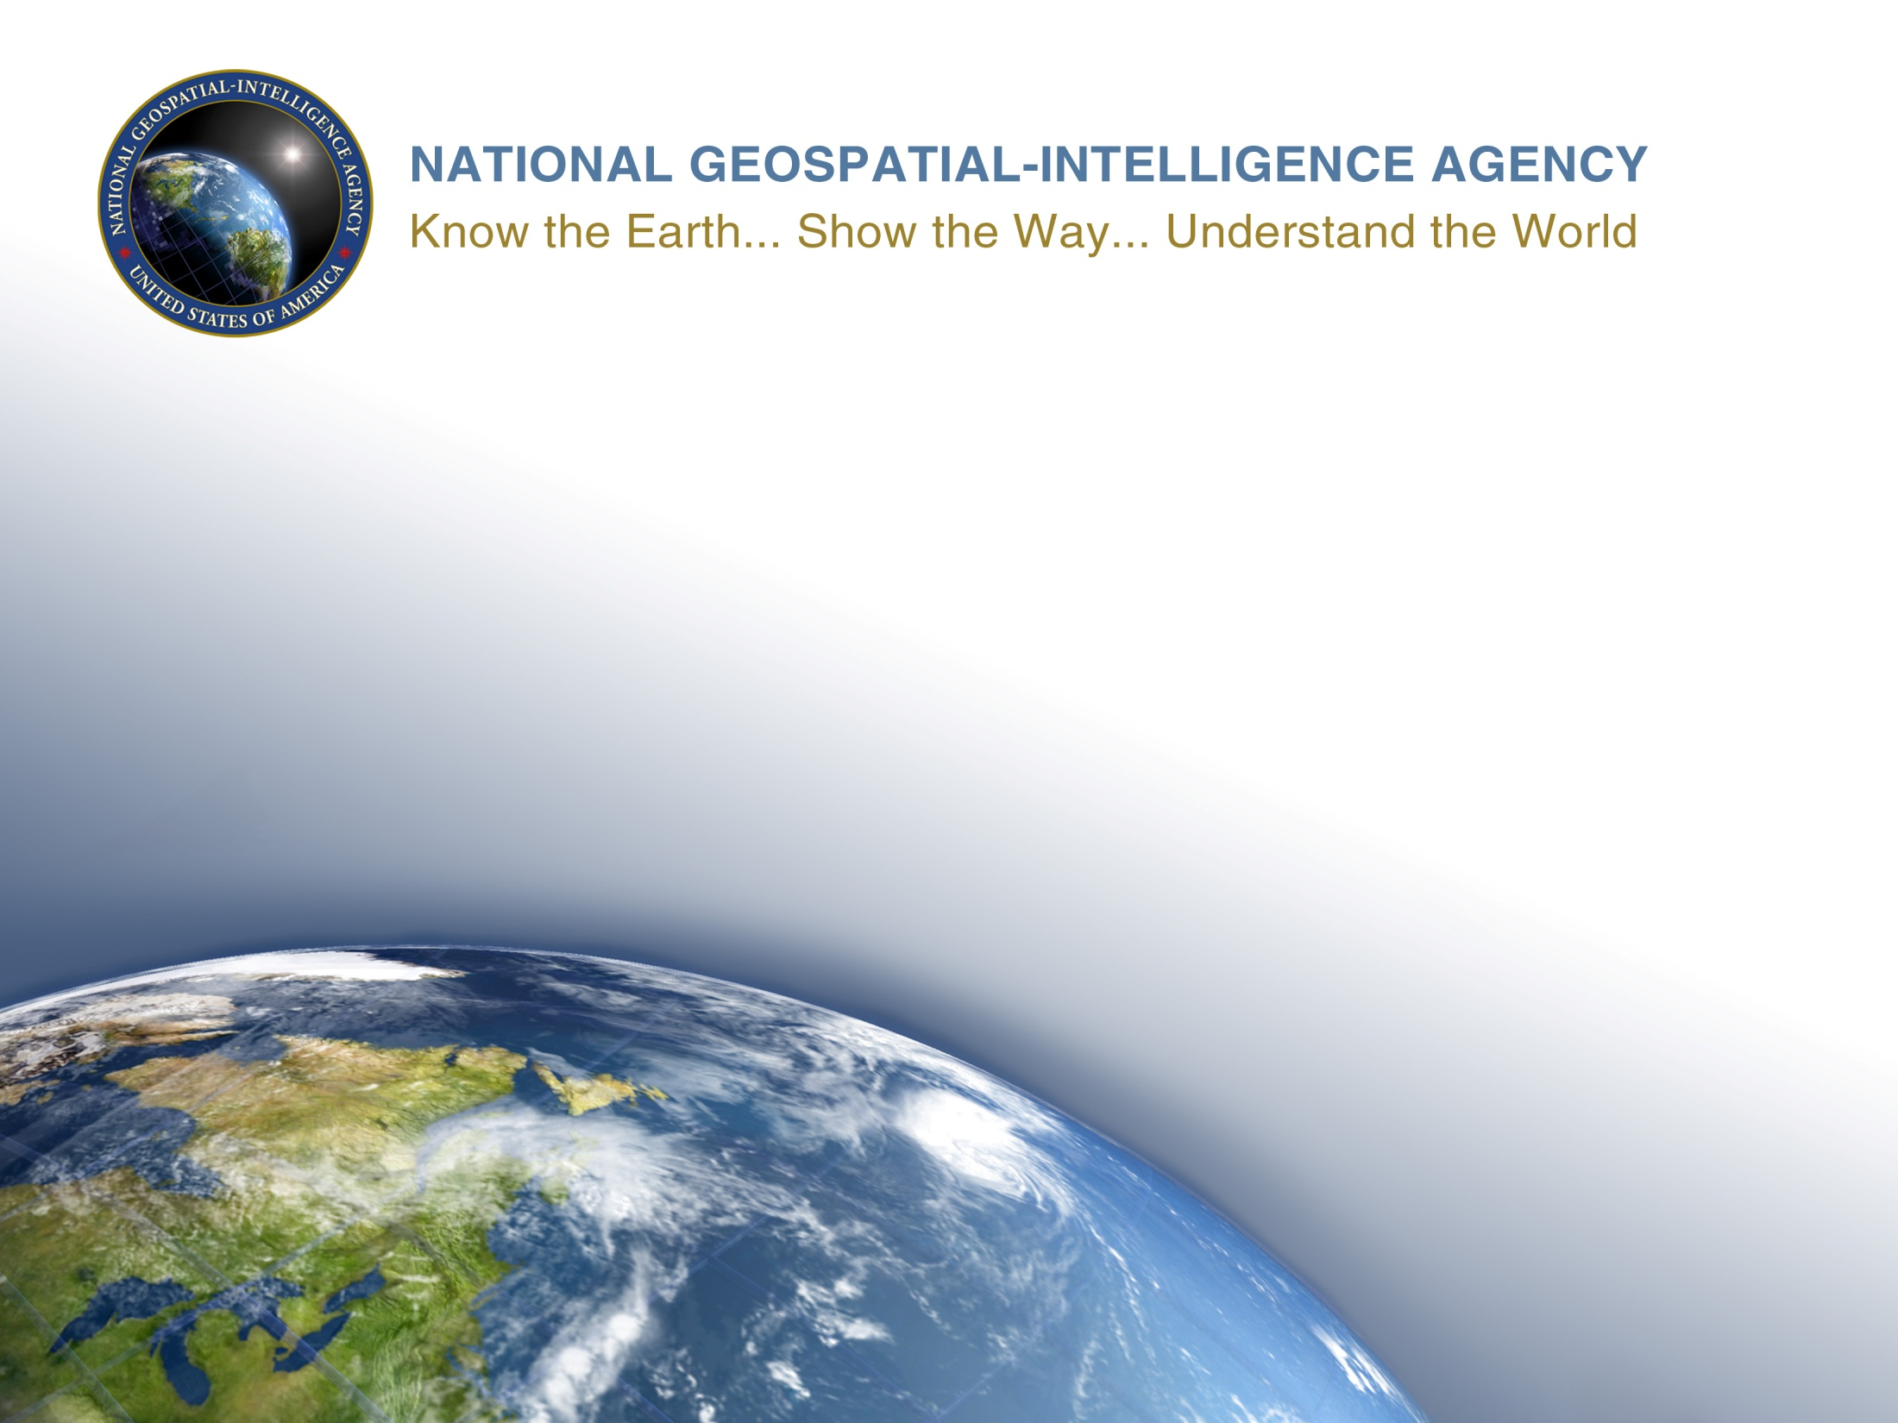
Proposal for Submarine Cables Text Box (NIPWG Action Item 2-20)
Michael Kushla (NGA)/Ludovico Sturla (IHI)/ Alain Rouault (SHOM)
8 December 2016
1

Slide 2
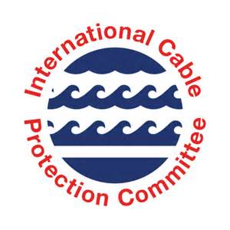
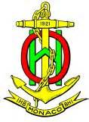
International Hydrographic Organization (IHO)/International Cable Protections Committee (ICPC) Memorandum of Understanding (MoU)
Signed on 18 April 2016.
Specifies the scope of cooperation between the IHO and the ICPC.

Slide 3
International Hydrographic Organization (IHO)/International Cable Protections Committee (ICPC) Memorandum of Understanding (MoU)
Merges the following interests: 1. IHO interest in the uniformity of nautical charts, charting standards, safety at sea, and protection of the marine environment. 2. ICPC interest in protecting submarine cable infrastructure and ensuring these protective measures have a minimal impact on the marine environment.

Slide 4
UNCLASSIFIED
One section of the MoU had the potential to affect NIPWG work.
From IHO Circular Letter 18/2016 of 18 April 2016
“The development of standard information in nautical publications drawing the mariners’ attention to the necessity to protect cables against damage caused by ship operations.”
4
UNCLASSIFIED

Slide 5
UNCLASSIFIED
Hydrographic Office sources consulted to develop the text box for Submarine Cable Protection Information:
Australia—Annual Notice No. 14 of 2015.
Belgium—Annual Notice No. 1/30 of 2016.
Italy—Annual Notice No. 8 of 2016.
Japan—Pub. 304 (Part 1, Chapter 7, Page 21).
South Africa—Annual Notice No. 23 of 2015.
United Kingdom—BA NP 100, Mariners Handbook (paragraph 9.43).
United States (NGA)—Special Paragraph No. 13 from Notice to Mariners 1/2016.
United States (NOS)—Coast Pilot 1 (Chapter 1, paragraphs 1.20 to 1.25).
5
UNCLASSIFIED

Slide 6
Cable Protection Information from Hydrographic Office Sources
Topic | Instances
Consequences of cable damage | 7
What to do in case of fouling a cable | 6
Warning regarding operations near a submarine cable | 5
Possible depth changes and exposure of a cable | 2
Lowering a fouled cable to the seabed | 2
Existence of protected area around cable | 2
Reporting requirements | 2
Posted warning signs | 1
Potential for natural disaster or fines | 1

Slide 7
Proposed Submarine Cable Text Box Information
Certain submarine cables are used for telecommunications functions while others carry high voltage. Damaging or severing a submarine cable, whether a telecommunications cable or a power cable, could rate as a national disaster and very severe criminal penalties may apply. Electrocution, with injury or loss of life, could occur if power cables are broached. Telecommunication cable damage may result in loss of voice, data transfer, or internet connectivity.
In view of the serious consequences resulting from damage to submarine cables, vessel operators should take special care when anchoring, fishing, mining, dredging, or engaging in underwater operations near areas where these cables may exist or have been reported to exist.
Mariners are also warned that the areas where cables were originally buried may have changed and they may be exposed; extreme caution should be used when operating vessels in depths of water comparable to the vessel’s draft.
Vessels fouling a submarine cable should attempt to clear without undue strain. Anchors or gear that cannot be cleared should be slipped, but no attempt should be made to cut a cable. Before any attempt to slip or cut gear from the cable is made, the cable should first be lowered to the seabed.
In inland areas or along the coast, warning signs or marker beacons are often erected to warn the mariners of the existence of submarine cables.

Slide 8
Proposed Submarine Cable Text Box Information (continued)
In order to avoid the risk of damaging submarine cables as much as possible, a 0.25-mile wide protected area¹ exists on either side of the cable. Anchoring is prohibited within this area, even when there is no specific prohibition on the chart.
Incidents involving the fouling of submarine cables should be reported immediately² to the appropriate authorities³ who should be advised as to the nature of the problem and the position of the vessel.
Notes:
¹ Each hydrographic authority can set this distance to a value they feel is appropriate.
² Each hydrographic authority can set the reporting time to a value they feel is appropriate.
³ The appropriate authorities can be listed here, as well as contact methods (telephone, facsimile, VHF, e-mail, internet, etc.) and required information.

Slide 9
Conclusions
The proposed Text Box for Submarine Cable Protection Information would meet the IHO/ICPC MoU requirement to develop a standard for the display of Submarine Cable Protection Information, whether incorporated in an ECDIS or printed on a hard copy chart.
NIPWG should consider submitting this paper to the next meeting of the Nautical Charting Working Group (NCWG). The information concerning the display of Submarine Cable Protection Information is also appropriate for display on a nautical chart.

Slide 10
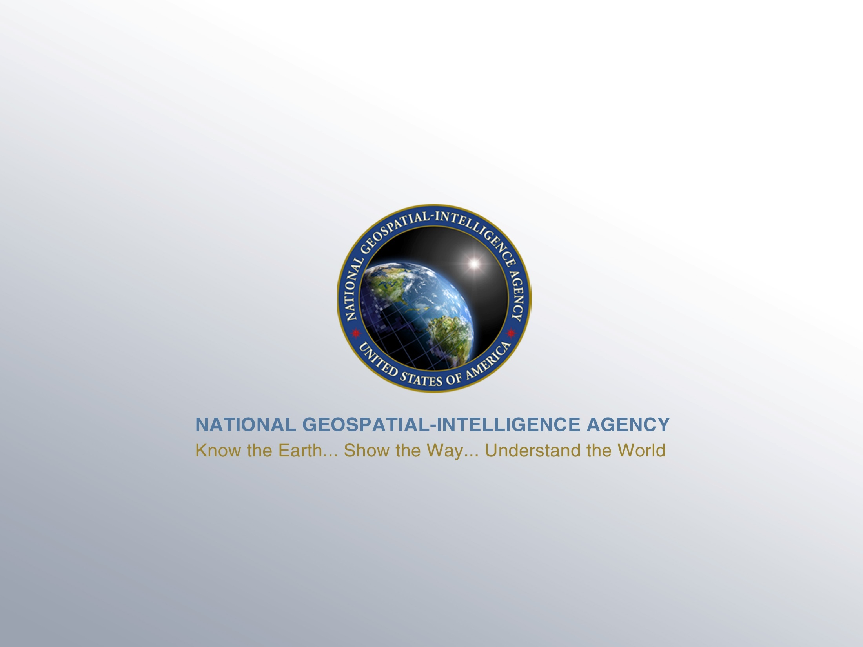
UNCLASSIFIED
10
UNCLASSIFIED

